Slide 1

UML Pain-T
Aubrey Kranz

Slide 2
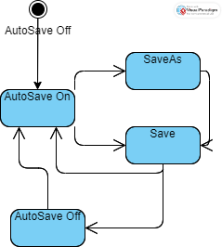
AutoSave State Diagram

Slide 3
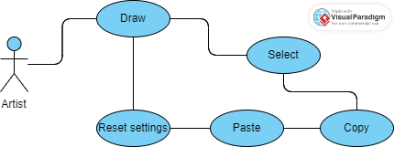
Use Case Diagram for Moving items

Slide 4
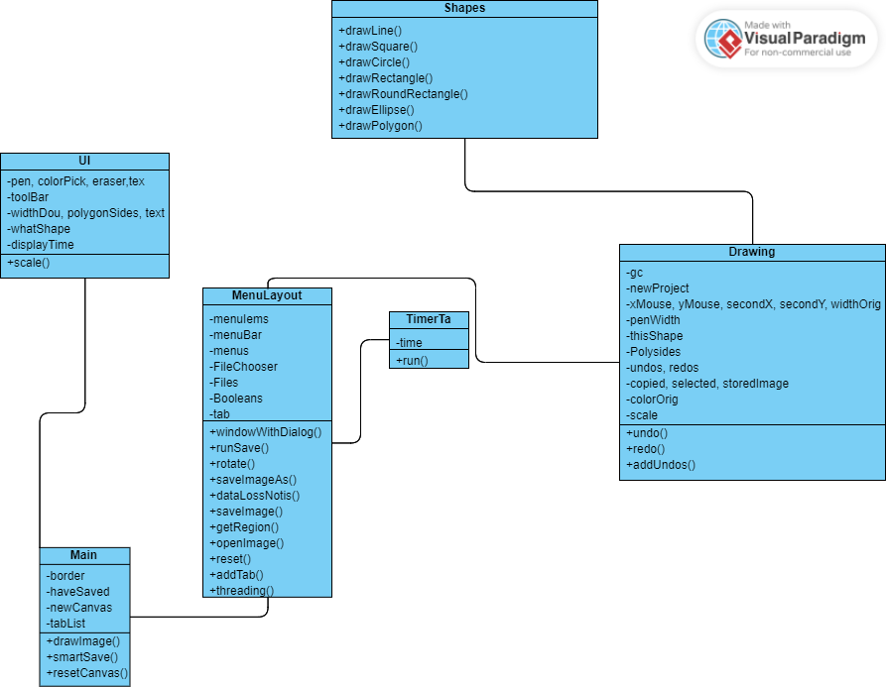
Class Diagram

Slide 5
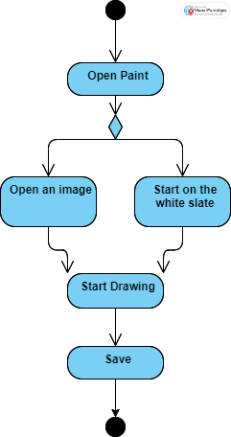
Activity Diagram Creating a Basic Drawing

